Slide 1
Outline of Today’s Discussion
Regression Analysis: Introduction
An Alternate Formula For Regression
Correlation, Regression, and Statistical Significance
Further Intuitions About The Degrees of Freedom

Slide 2
Part 1
Regression Analysis: Introduction

Slide 3
Regression Analysis Introduction
There is a close relationship between correlation and regression.
A synonym for regression is prediction! Recall that prediction is one of the (“fab”) four goals of the scientific method. What were the others?
A significant correlation implies a significant capacity for prediction, i.e., a prediction that is reliably better than chance!

Slide 4
Regression Analysis Introduction
In linear regression, the “regression line” is the best-fitting line to the data.
Potential Pop Quiz Question: Given that we could fit an infinite number of lines to a data set, how do we determine which is the best-fitting line? Explain in your own words. (Note: The answer is not in your text, it’s in your intuitions!)

Slide 5
Regression Analysis Introduction
The equation for a straight line, again, is:
y = mx + B
or
Criterion = (slope * Predictor) + Intercept
How many “parameters” in a linear equation?
How about a quadratic equation?
How about a Gaussian distribution?

Slide 6
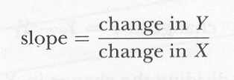
Regression Analysis Introduction
Slope can also be though of as
“rise over run”.

Slide 7
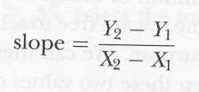
Regression Analysis Introduction
The “rise” on the ordinate = Y₂ - Y₁.
The “run” on the abscissa = X₂ - X₁.

Slide 8
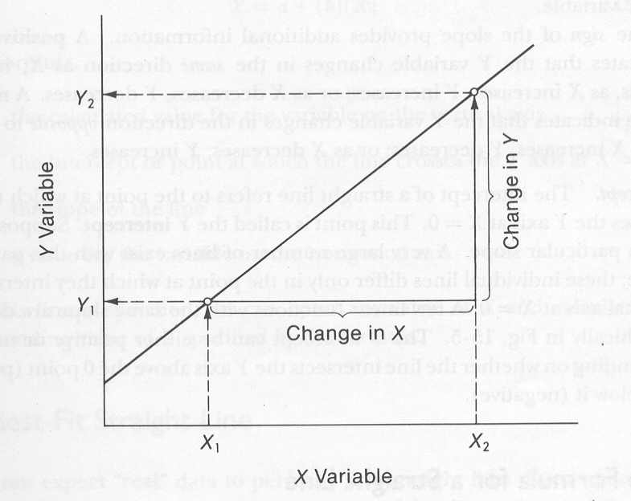
Regression Analysis Introduction
“Rise over run” in pictures.

Slide 9
Regression Analysis Introduction
Here, the regression is “linear”…
Next week…no such luck! ☺

Slide 10
Regression Analysis Introduction
Note: Whenever our correlation is statistically significant, the slope of the best-fitting regression line is said to be significantly different from zero.
When the slope of the regression line is significantly different from zero, it is…
- a significantly better predictor than chance;
- a significantly better predictor than the MEAN!
Critical Thinking Question: How does the previous bullet item relate to the philosophical notion of “Ockham’s Razor”?

Slide 11
Regression Analysis Introduction

Slide 12
Regression Analysis Introduction
Once we have the slope,
it’s easy to get the y-intercept!

Slide 13
Part 2
An Alternate Formula
For Regression

Slide 14
Alternate Regression Formula
Predicted Z score on the criterion variable can be found by multiplying Z score on the predictor variable by that standardized regression coefficient
Standardized regression coefficient is the same thing as the correlation
For raw score predictions
Change raw score to Z score
Make prediction
Change back to raw score

Slide 15
Alternate Regression Formula
Potential Pop Quiz Question: What would the linear equation be for this alternate regression formula?

Slide 16
Alternate Regression Formula
Potential Pop Quiz Question: Why might you prefer to use one of these regression formulas over the other?

Slide 17
Multiple Correlation and Multiple Regression
Multiple correlation
Association between criterion variables and two or more predictor variables
Multiple regression
Making predictions about criterion variables based on two or more predictor variables
Unlike prediction from one variable, standardized regression coefficient is not the same as the ordinary correlation coefficient

Slide 18
Part 3
Correlation, Regression,
& Statistical Significance

Slide 19
Correlation, Regression & Statistical Significance
Let’s consider correlation & regression analysis within the context of our earlier work (this semester) on hypothesis testing…
In your own words, what is the meaning of the so-called “critical value” for hypothesis testing?
Potential Pop Quiz Question: What two factors determine the critical value (i.e., the number to beat) when we engage in hypothesis testing? (The answer is not in your text…but it might be in your critical thinking, or your memory of research methods.)

Slide 20
Correlation, Regression & Statistical Significance
DF for Correlation & Regression
Here n stands for the number of
pairs of scores.
Why would this be n-2,
rather than the usual n-1?

Slide 21
Correlation, Regression & Statistical Significance
In general, the formula for the degrees of freedom is the number of observations minus the number of parameters estimated.
For linear correlation, we have one estimate for the mean of X, and another estimate for the mean of Y.
For linear regression, we have one estimate for the slope, and another estimate for y intercept.

Slide 22
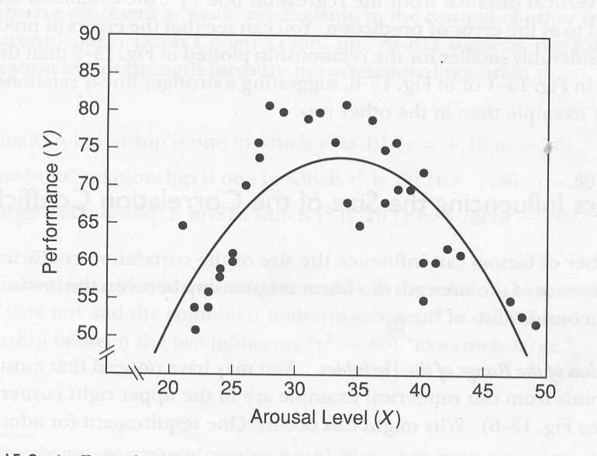
Correlation, Regression & Statistical Significance
What would the DF be for this function? Explain.

Slide 23
Correlation, Regression & Statistical Significance
Note: The a slope can be very modestly different from zero, and still be “statistically significant” if all data points fall very close to the line.
In correlation and regression, statistical significance is determined by the strength of the correlation between two variables (the r-value), and NOT by the slope of the regression line. (This statement is relevant to regressions involving raw scores, not z-transformed scores)
The significance of the r-value, as always, depends on the alpha level, and the df (which is n-2). Take a peak at the r-value table.

Slide 24
Correlation, Regression & Statistical Significance
Remember: The regression line (equation) can help us predict one score, given another score, but only if there is a significant r-value.
The terminology w/b… “the regression line explains (or accounts for)” 42% of the variability in the scores (if r-squared = .42).
To “explain” or “account for” does NOT mean “to cause”.
Correlation does not imply causation!

Slide 25
Part 4
Further Intuitions About
Degrees of Freedom

Slide 26
Further Intuitions About DF
To understand the concept called “degrees of freedom”, we should remember that dfs are used when we are making estimates.
When we are using ANOVA, population means are estimated, based on samples.
Let’s consider some simple examples…

Slide 27
Further Intuitions About DF
Could someone generate a list of three numbers that has a mean equal to 10?
Could someone else generate a different list of three numbers having a mean equal to 10?
And, one last list of three numbers with a mean equal to 10?

Slide 28
Further Intuitions About DF
Now, lets consider how many scores in a set are free to vary, once we’ve estimated the mean to be 10.
Would someone now generate any two numbers? (I’ll generate the third number so that the mean is 10.)
Would someone now generate any two other numbers? (I’ll generate the third number so that the mean is 10.)
One more time, would someone now generate any two other numbers? (I’ll generate the third number so that the mean is 10.)

Slide 29
Further Intuitions About DF
Hopefully you see a pattern now. That is, all scores in a set are free to vary…except “the last one”, if the set of scores is to have the mean that we are estimating.
In other words, if we claim that we believe that the population mean associated with a particular sample of three observations is, say, 10, then only the first two scores are free to vary (we have 2, or n-1, “degrees of freedom”).
The last score is NOT free to vary…it is fixed, if we are to achieve our mean.

